Slide 1

COVID-19 WORLD REPORTS
B.KRISHNAPRIYA
AF0426112
ANP-C8713

Slide 2
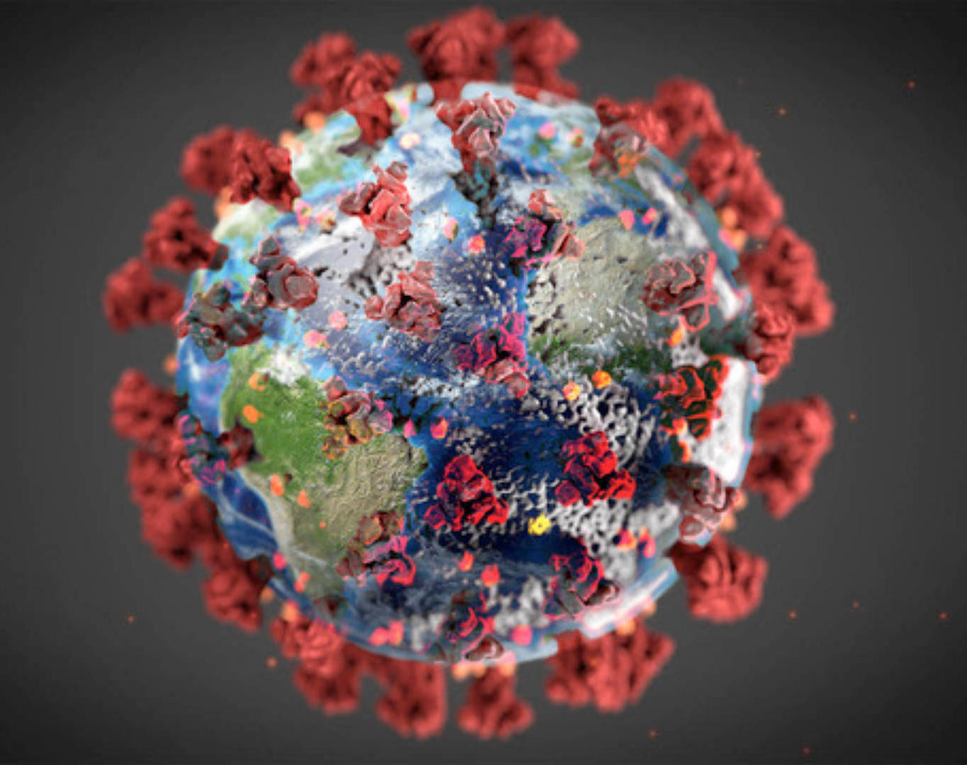
Covid-19 WORLD Data
1. Case Data
Confirmed Cases: The total number of confirmed COVID-19 cases.
Active Cases: The number of ongoing infections.
Recovered Cases: The number of individuals who have recovered.
Deaths: Total deaths attributed to COVID-19.

Slide 3
INDEX
Covid-19
Impact of covid-19
Vaccination efforts & importance
Dashboard
Country wise report
Stacked bar graph
Pie chart
Line Chart
Map
Details
Case studies
Conclusion

Slide 4
COVID-19
COVID-19 is a highly contagious respiratory illness caused by the novel coronavirus SARS-CoV-2.
Origin and Transmission: The virus was first identified in Wuhan, China, in December 2019. It spreads primarily through respiratory droplets when an infected person coughs, sneezes, or talks.
Symptoms: Common symptoms include fever, cough, fatigue, and difficulty breathing. Some people may experience loss of taste or smell, muscle aches, and sore throat.

Slide 5

IMPACT OF COVID-19
Global Statistics:
Infection Rates: Over [675million] confirmed cases worldwide.
Mortality Rates: [7 million] deaths globally.
Economic Impact:
Global economic contraction.
Job losses and business closures.
Impact on global supply chains.
Social and Psychological Effects:
Increased anxiety and stress levels.
Social isolation and loneliness.
Rise in mental health issues.

Slide 6
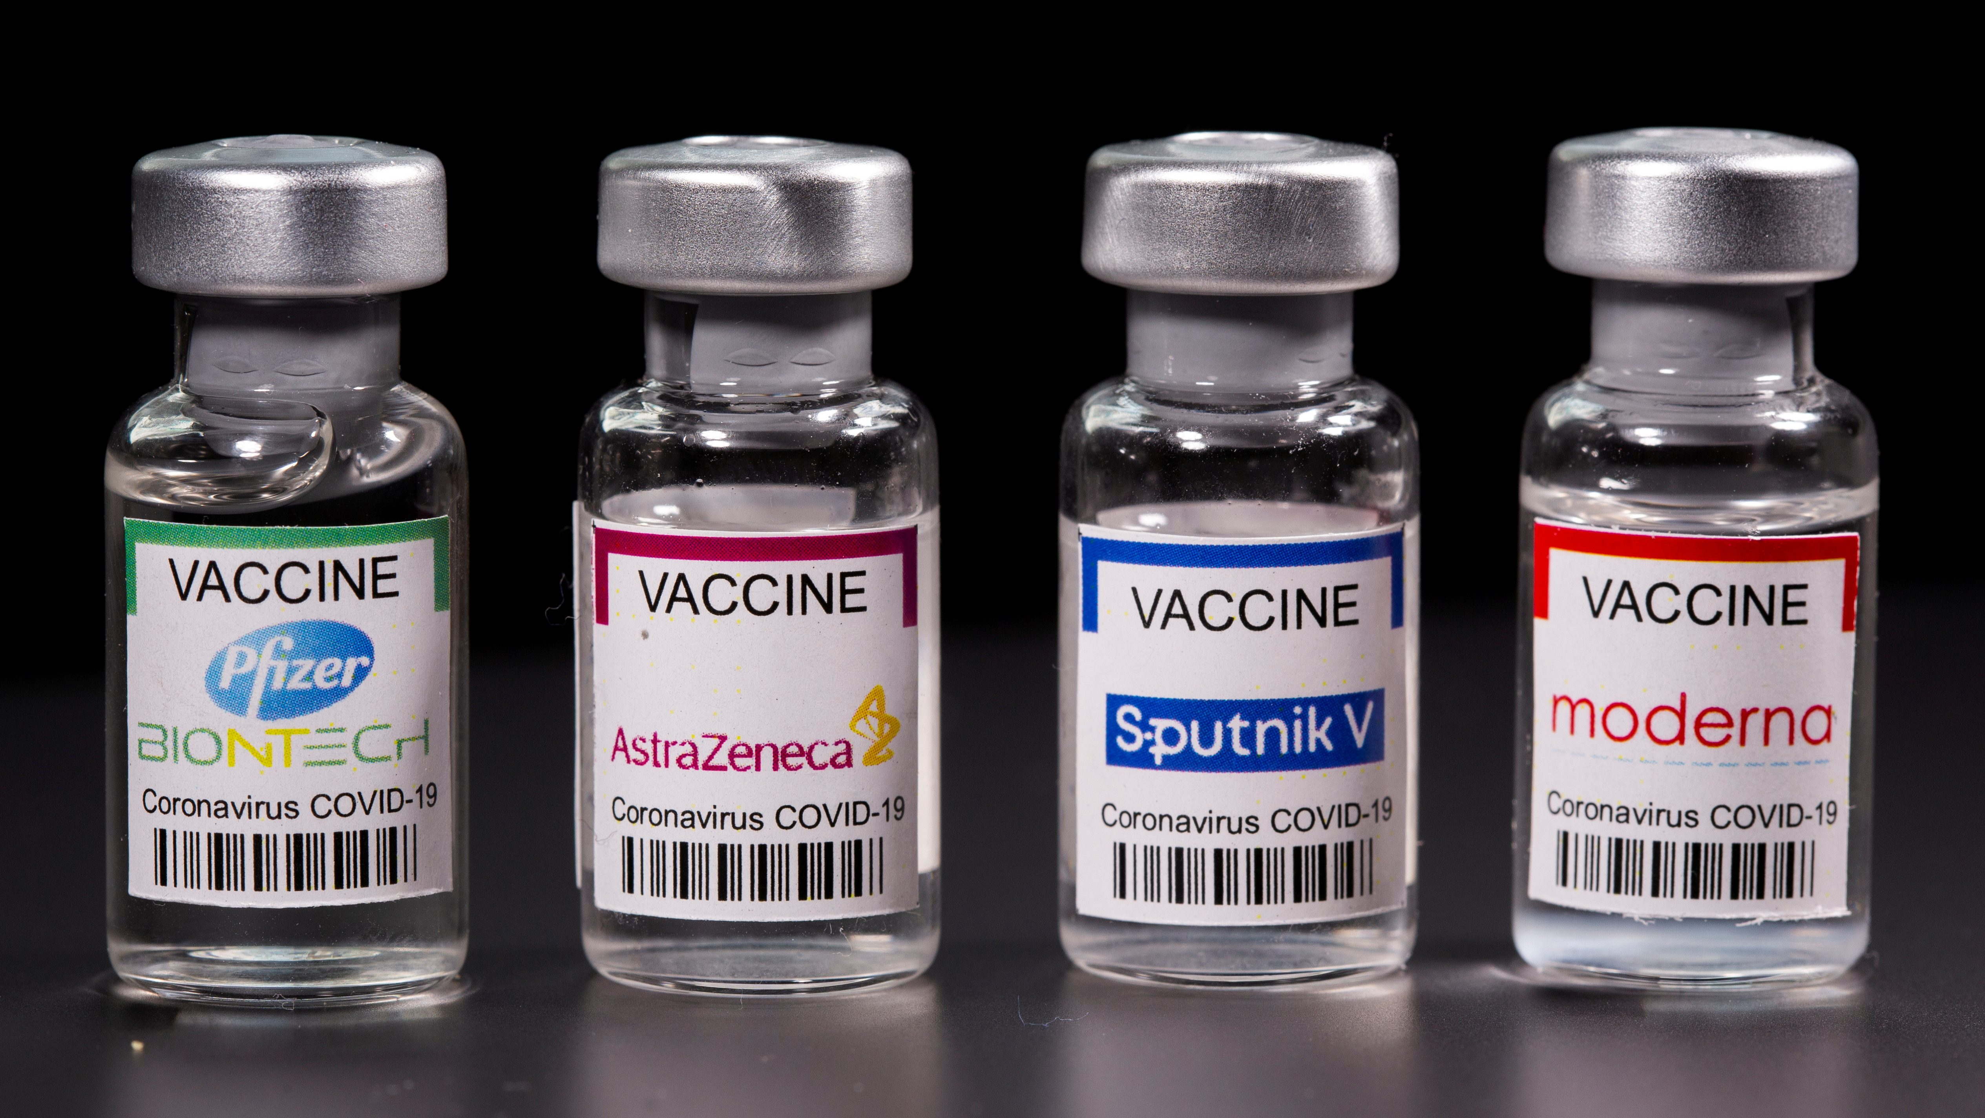
VACCINATION EFFORTS&IMPORTANCE
Types of Vaccines Available:
mRNA Vaccines: Pfizer-BioNTech, Moderna.
Viral Vector Vaccines: AstraZeneca, Johnson & Johnson.
Protein Subunit Vaccines: Novavax.
Inactivated or Attenuated Vaccines: Sinovac, Sinopharm.
Importance of Getting Vaccinated:
Preventing Severe Illness: Reduces the risk of severe disease, hospitalization, and death.
Herd Immunity: Helps achieve community protection by reducing virus transmission.
Economic and Social Stability: Enables safer reopening of economies and return to normal activities.

Slide 7
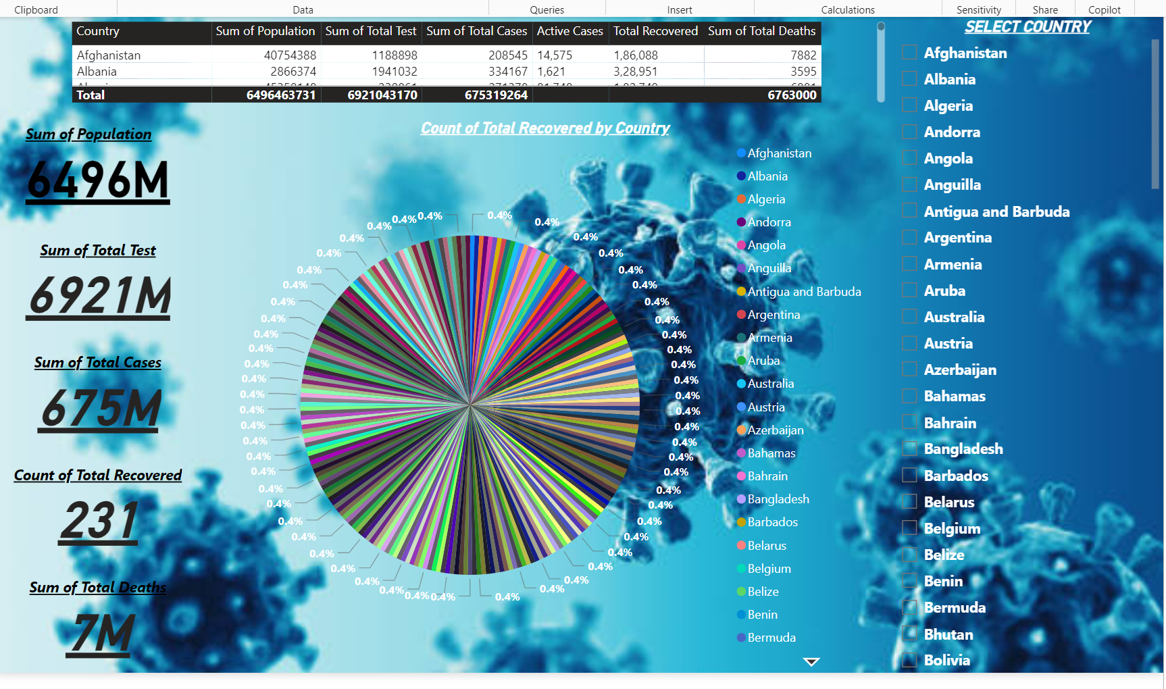
Dashboard

Slide 8
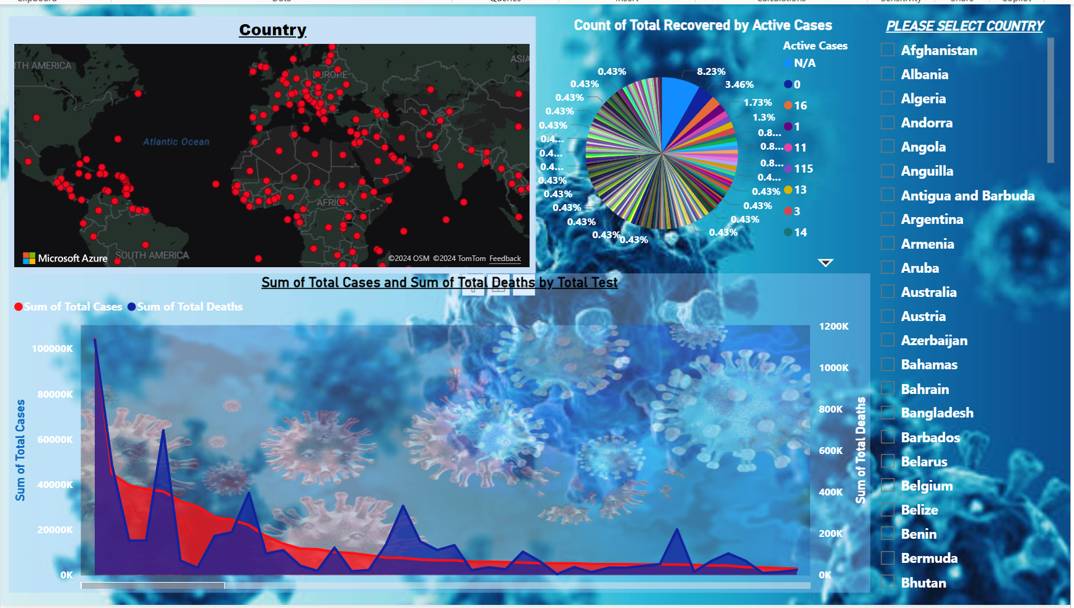
COUNTRY WISE REPORT

Slide 9
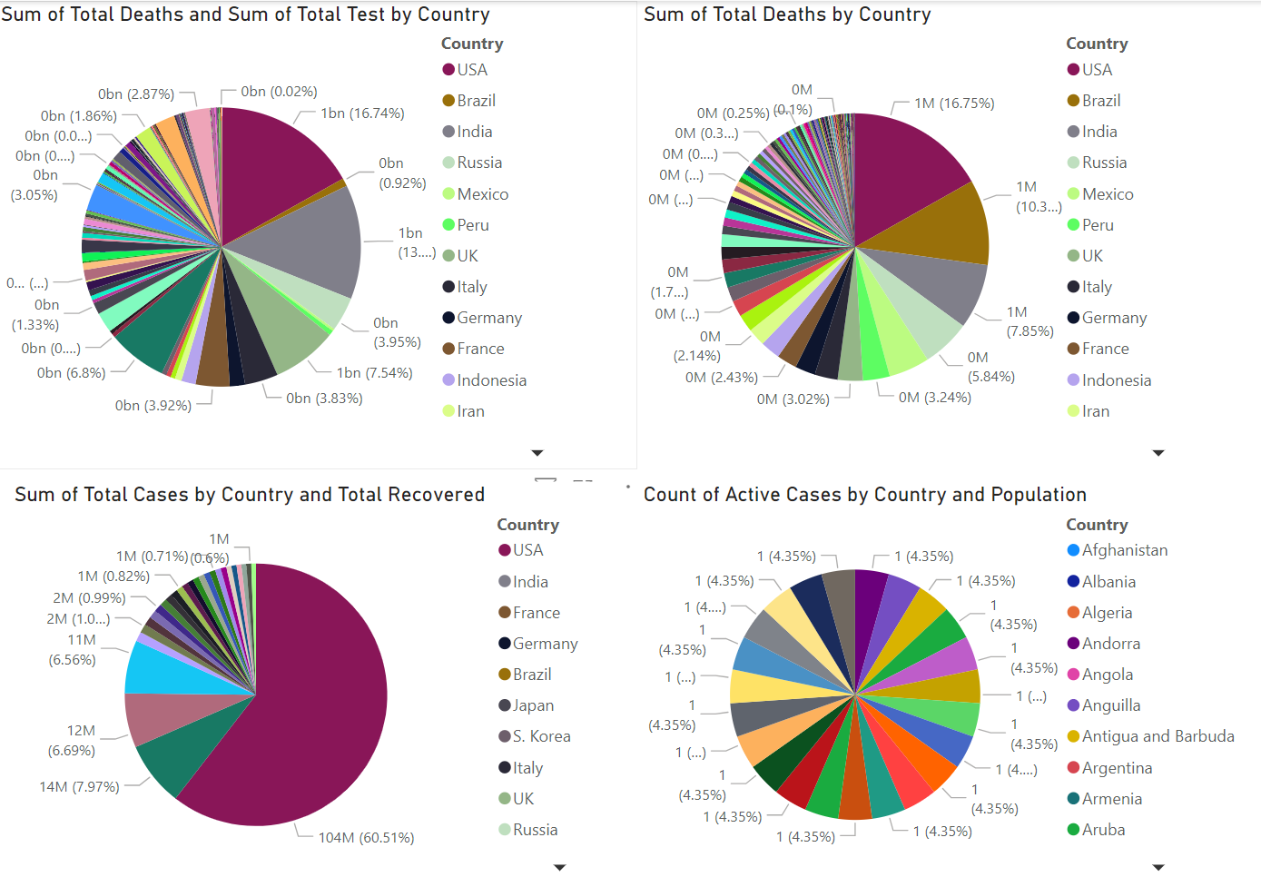
PIE CHART

Slide 10
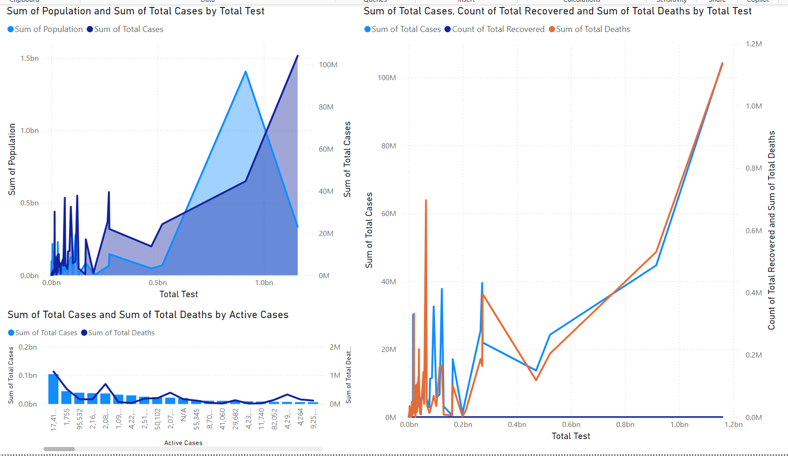
LINE CHART

Slide 11
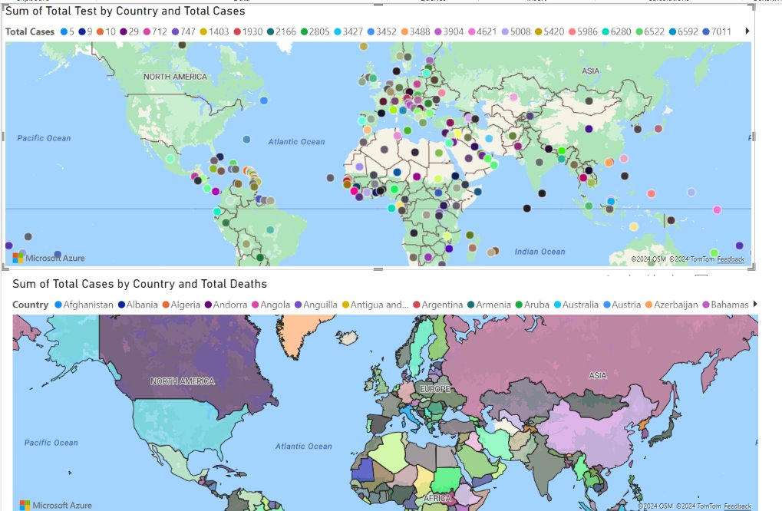
MAP

Slide 12
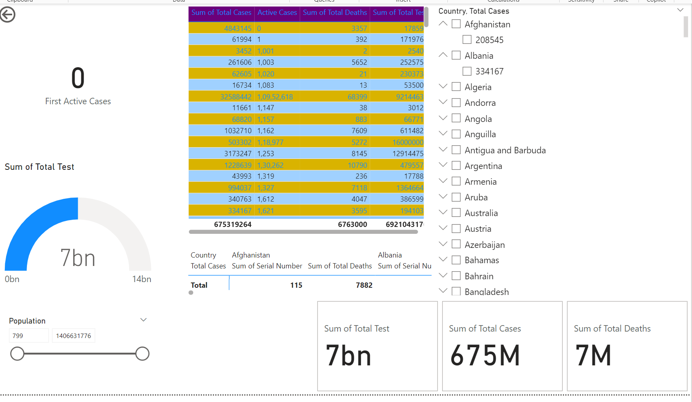
DETAILS

Slide 13

CASE STUDIES
Challenges Faced and Solutions Implemented:
India: Faced a severe second wave with high infection rates. Implemented extensive vaccination drives and established temporary hospitals.
Brazil: Struggled with high case numbers due to delayed response. Improved through mass vaccination and public health campaigns.
United States: Initial challenges with testing and healthcare capacity. Overcame through rapid vaccine development and distribution efforts.

Slide 14
CONCLUSION
Key Takeaways:
COVID-19 has had a profound impact globally, affecting every aspect of life.
Preventive measures and vaccinations are crucial in controlling the spread of the virus.
Learning from success stories and challenges helps us better prepare for future health crises.
Future Outlook and Final Thoughts:
Continued vigilance and adherence to health guidelines are essential to managing the pandemic.
Advancements in medical research and technology offer hope for more effective treatments and prevention strategies.
Global collaboration and sharing of knowledge are key to overcoming this and future pandemics.

Slide 15


